Slide 1
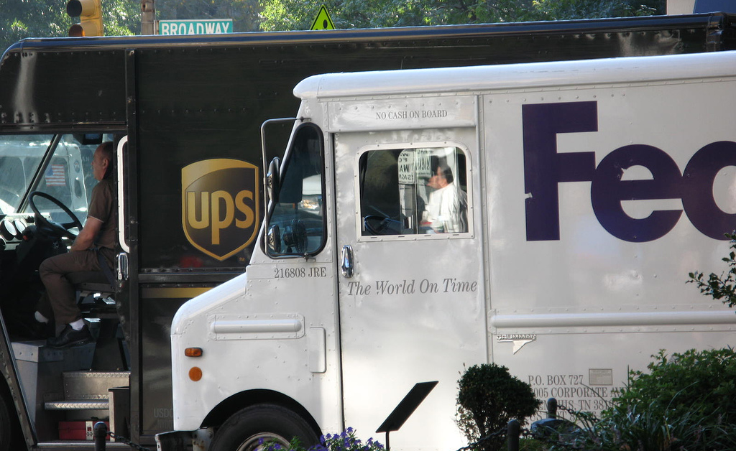

Freight Master Plan
Bicycle Advisory Board
September 2, 2015

Slide 2
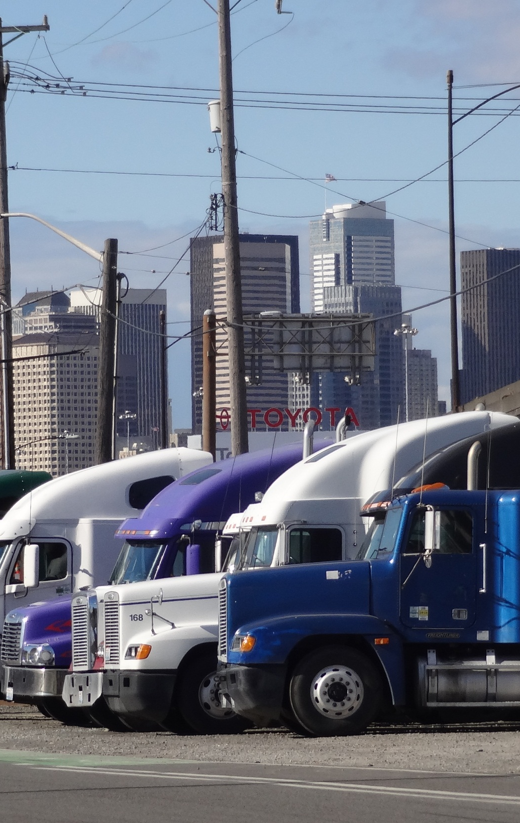
Plan purpose
Improve goods movement while sustaining Seattle’s quality of life and maintaining economic competitiveness
Safety
Economic vibrancy
Equity
Efficiency/Reliability
Environmental impacts
2
Notes:
Efficient movement of goods is critical in sustaining the city’s quality of life and maintaining its competitiveness.
Improve freight mobility to support increasing demand for goods and services while addressing
We all depend on goods being delivered safe and efficiently

Slide 3
Transportation planning framework
Seattle Comprehensive Plan
Climate Action Plan
Modal Plans
Operational Plans
Sub-Area Plans
Bicycle Master Plan
Freight Master Plan
Transit Master Plan
Pedestrian Master Plan
Notes:
Where is the FMP?

Slide 4
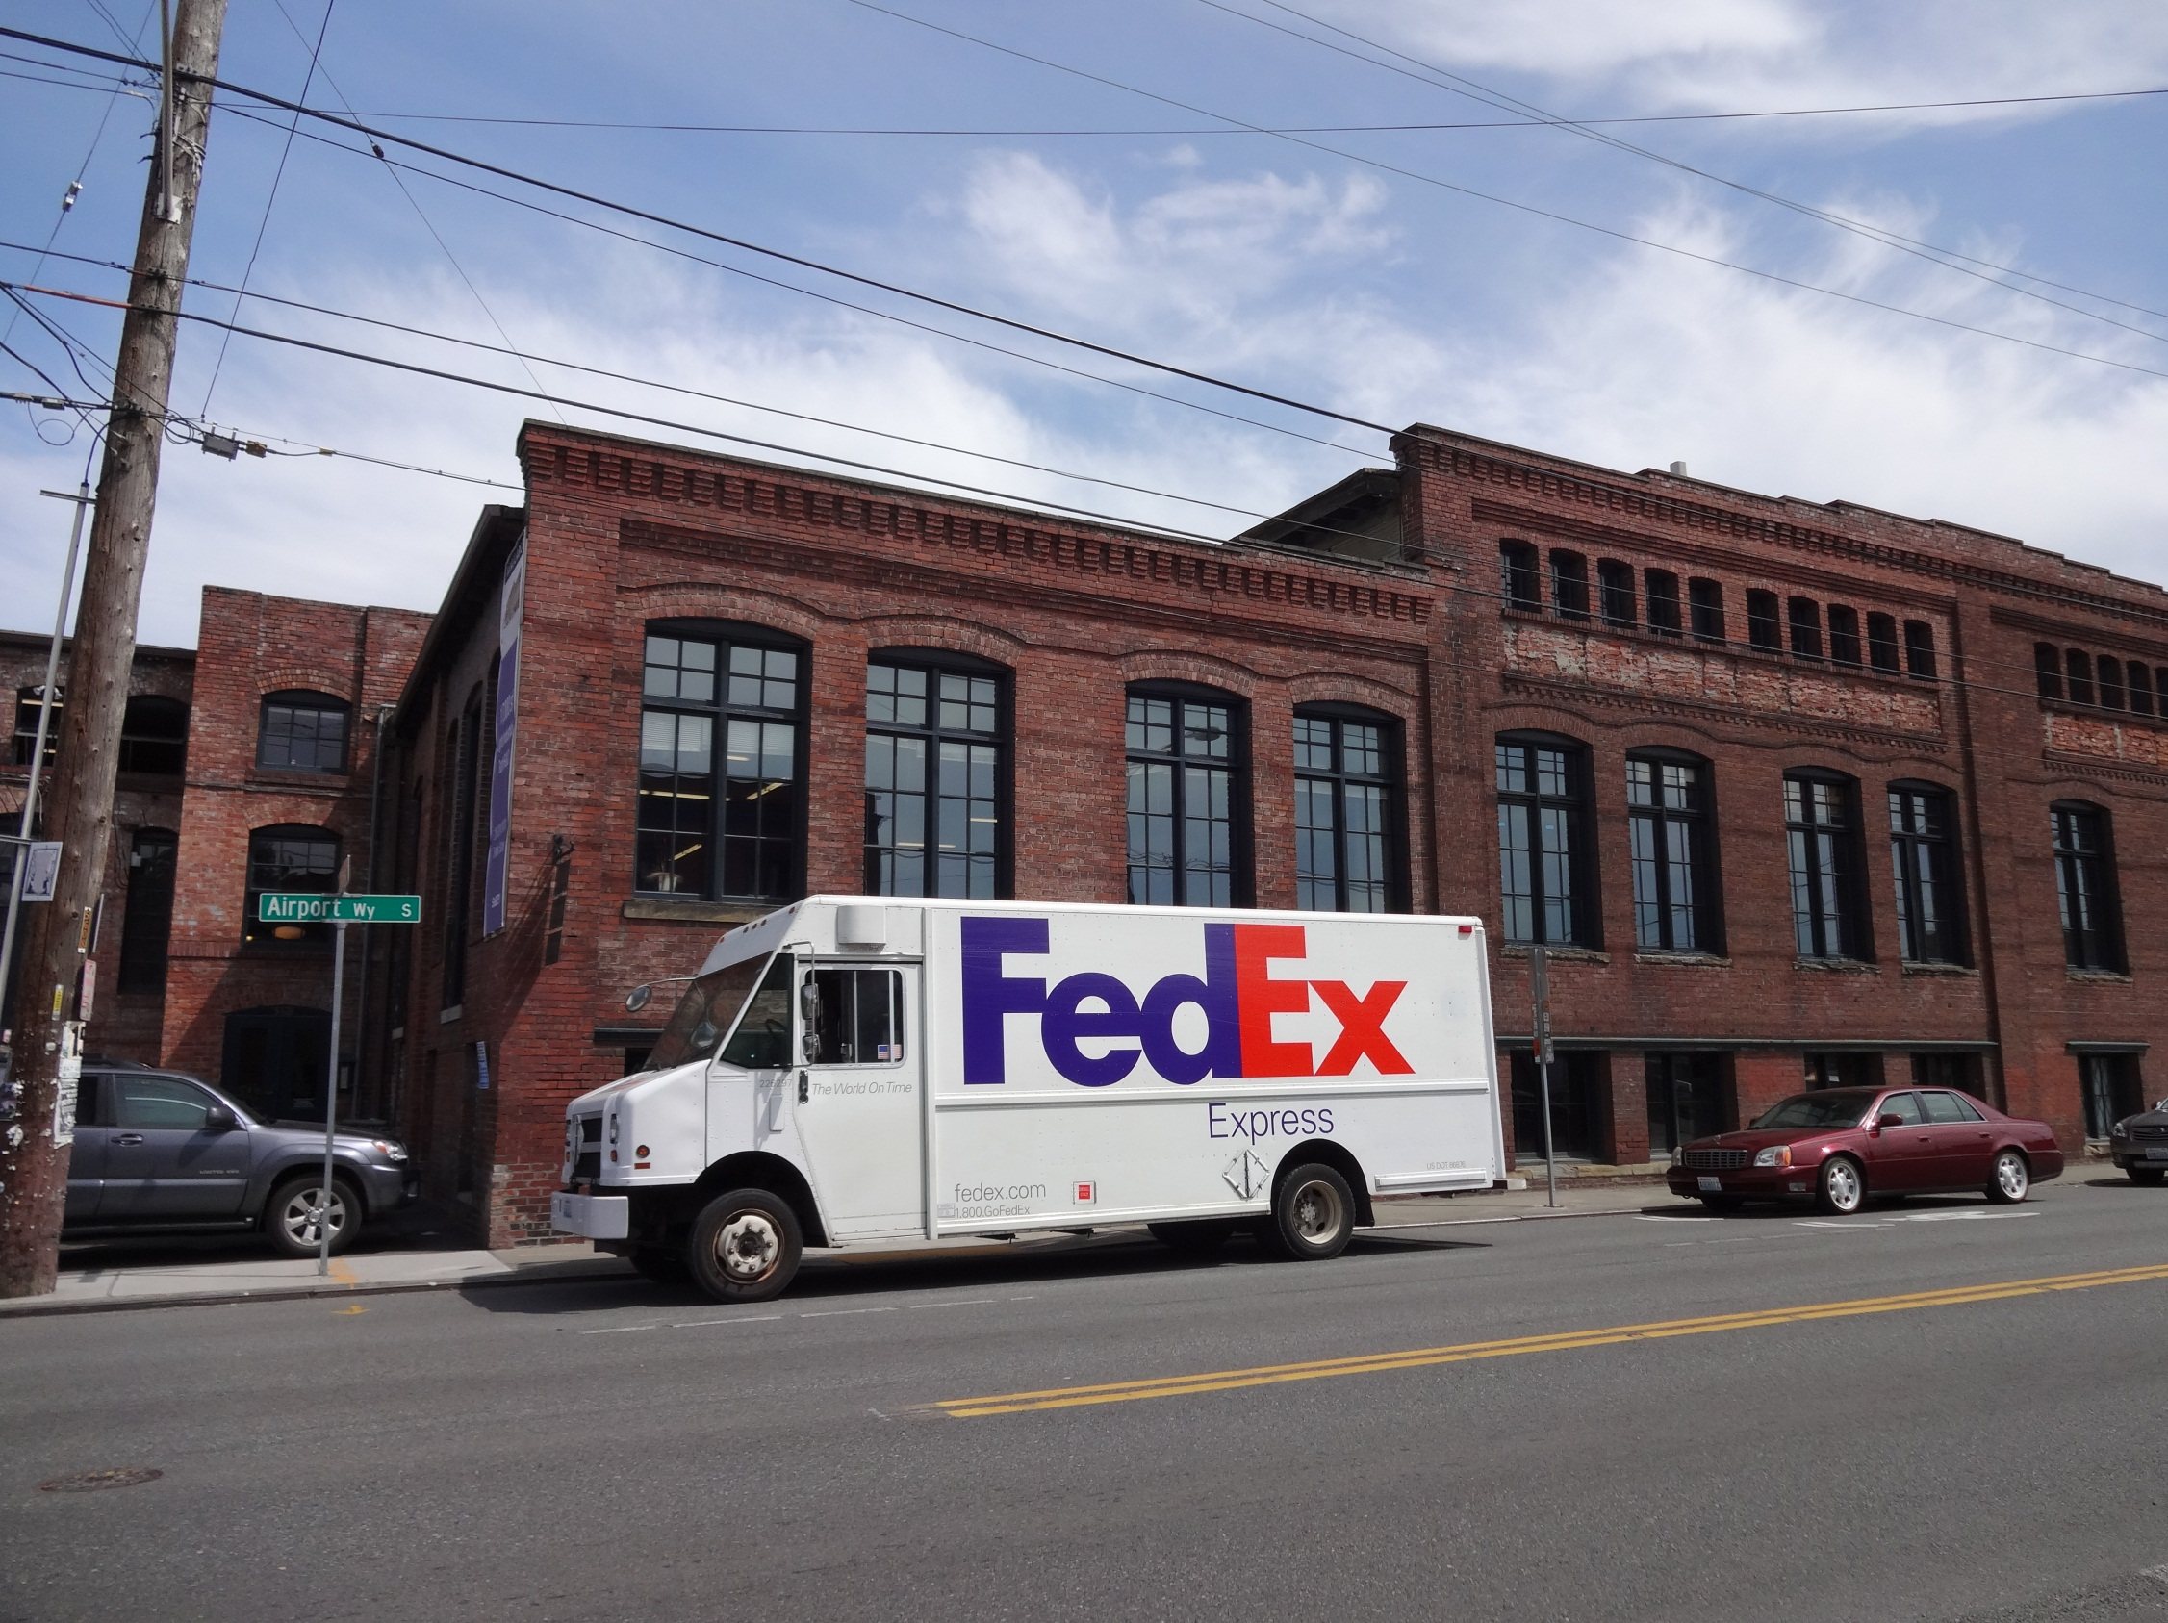
Project structure
Freight Master Plan Advisory Committee
Advise the SDOT project team during the development of the FMP
Comprised of freight industry, City Boards and Commissions, and community representatives
Committee has had seven meetings
4
Notes:
Who is in our Advisory Committee?

Slide 5
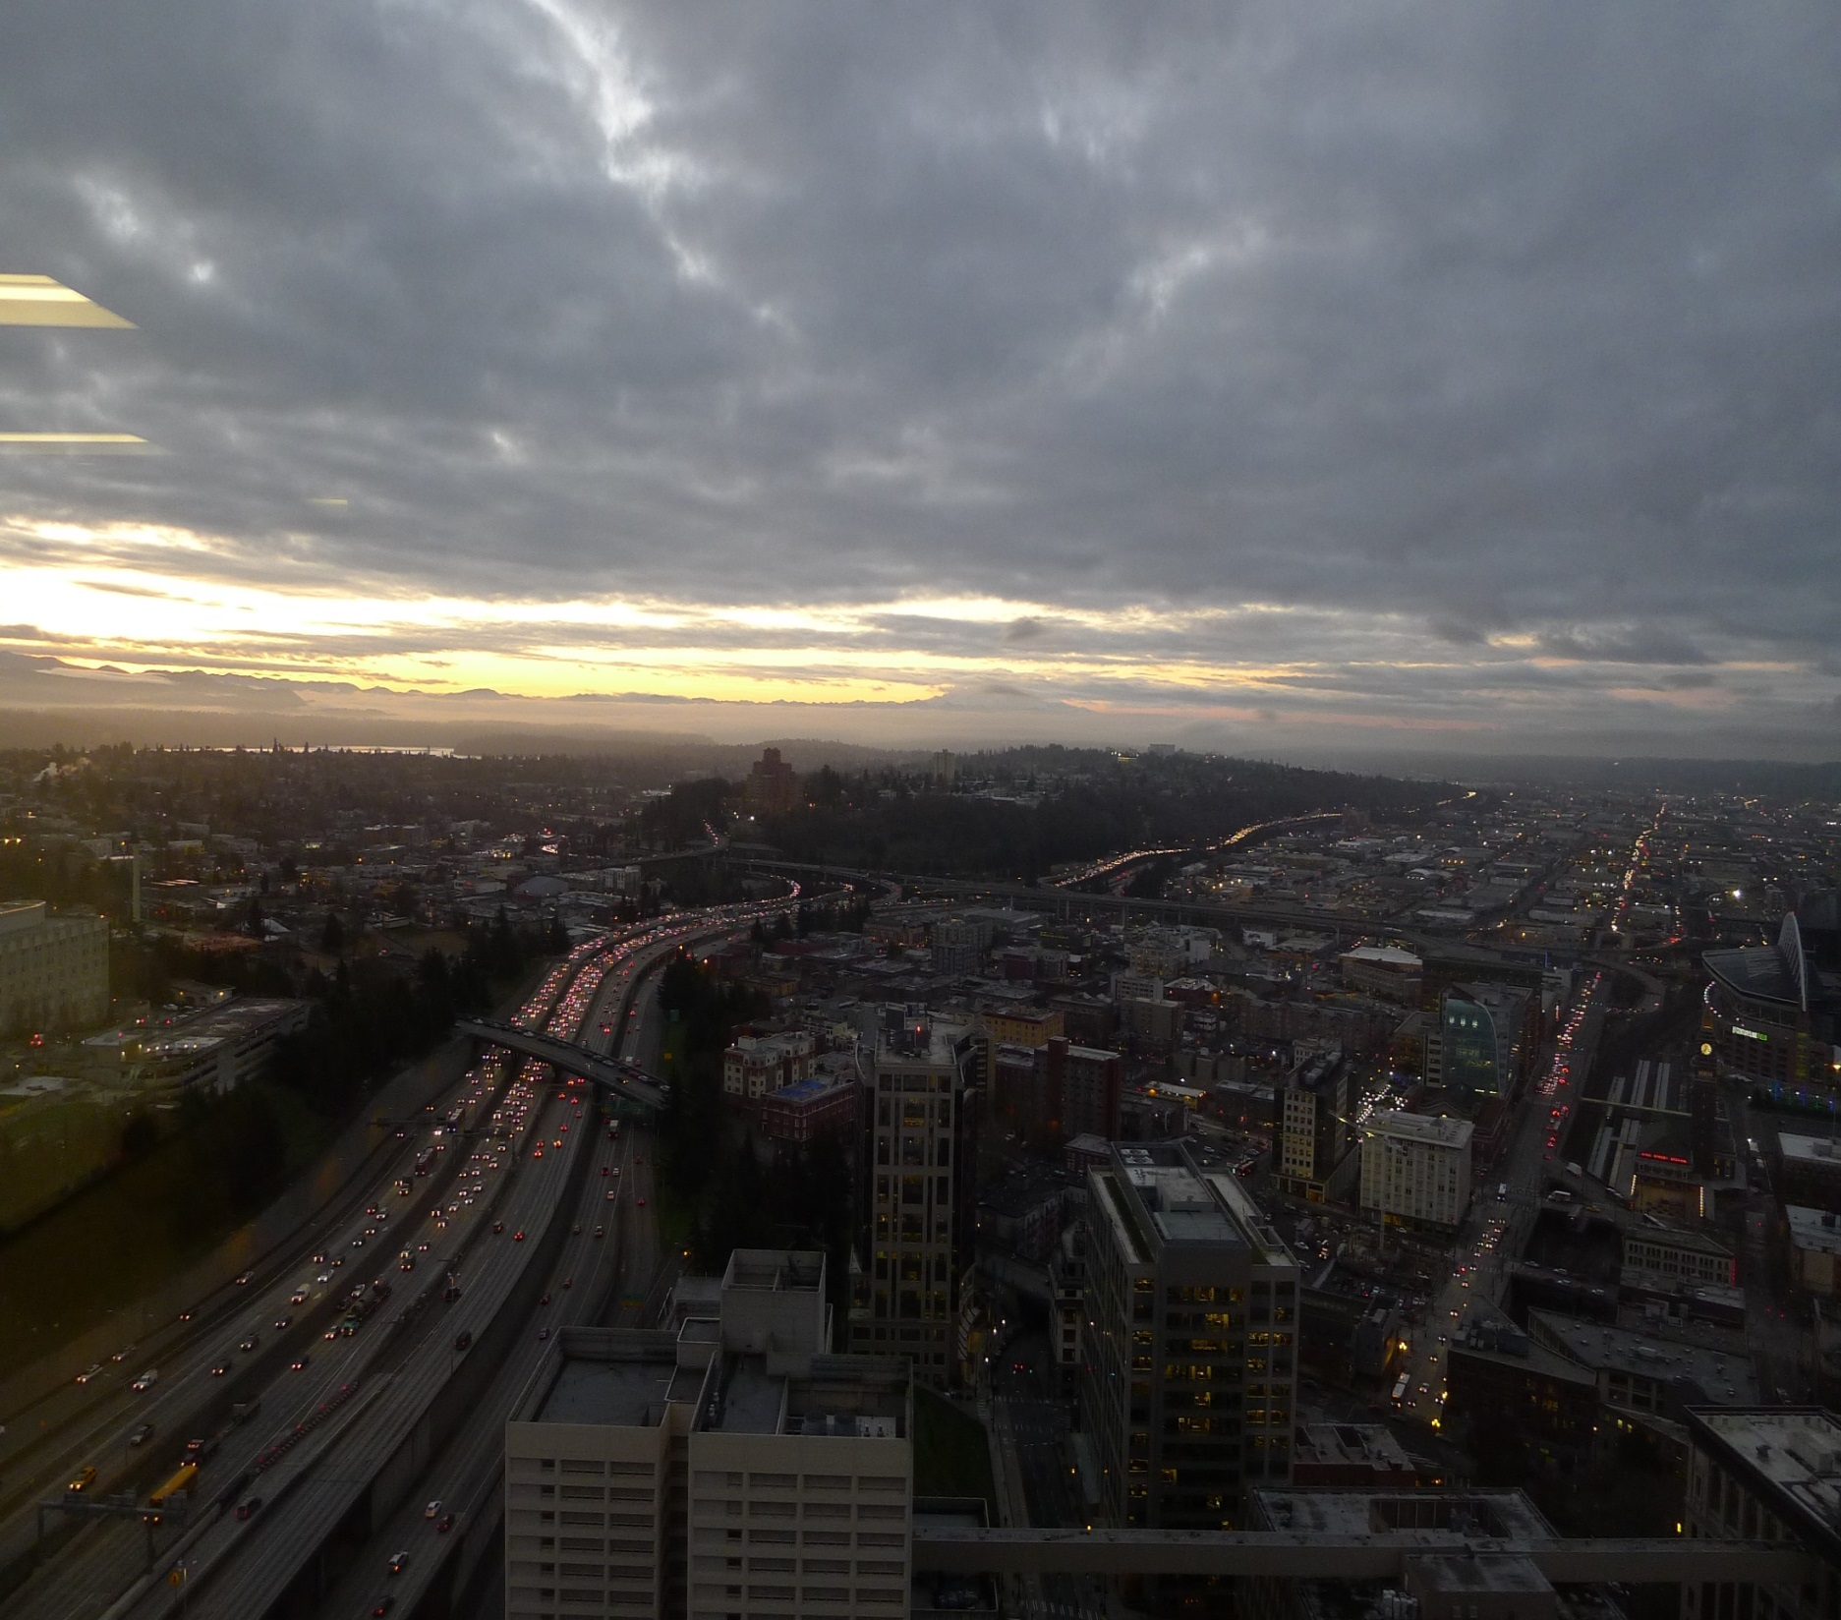
Project Scope
Public outreach and stakeholder engagement
Existing conditions
Policy framework
Evaluation of future conditions
Updated freight network (map)
Freight improvements and design guidelines
Implementation strategy
Final plan
5
Notes:
Talk about all the deliverables and where we are to date

Slide 6
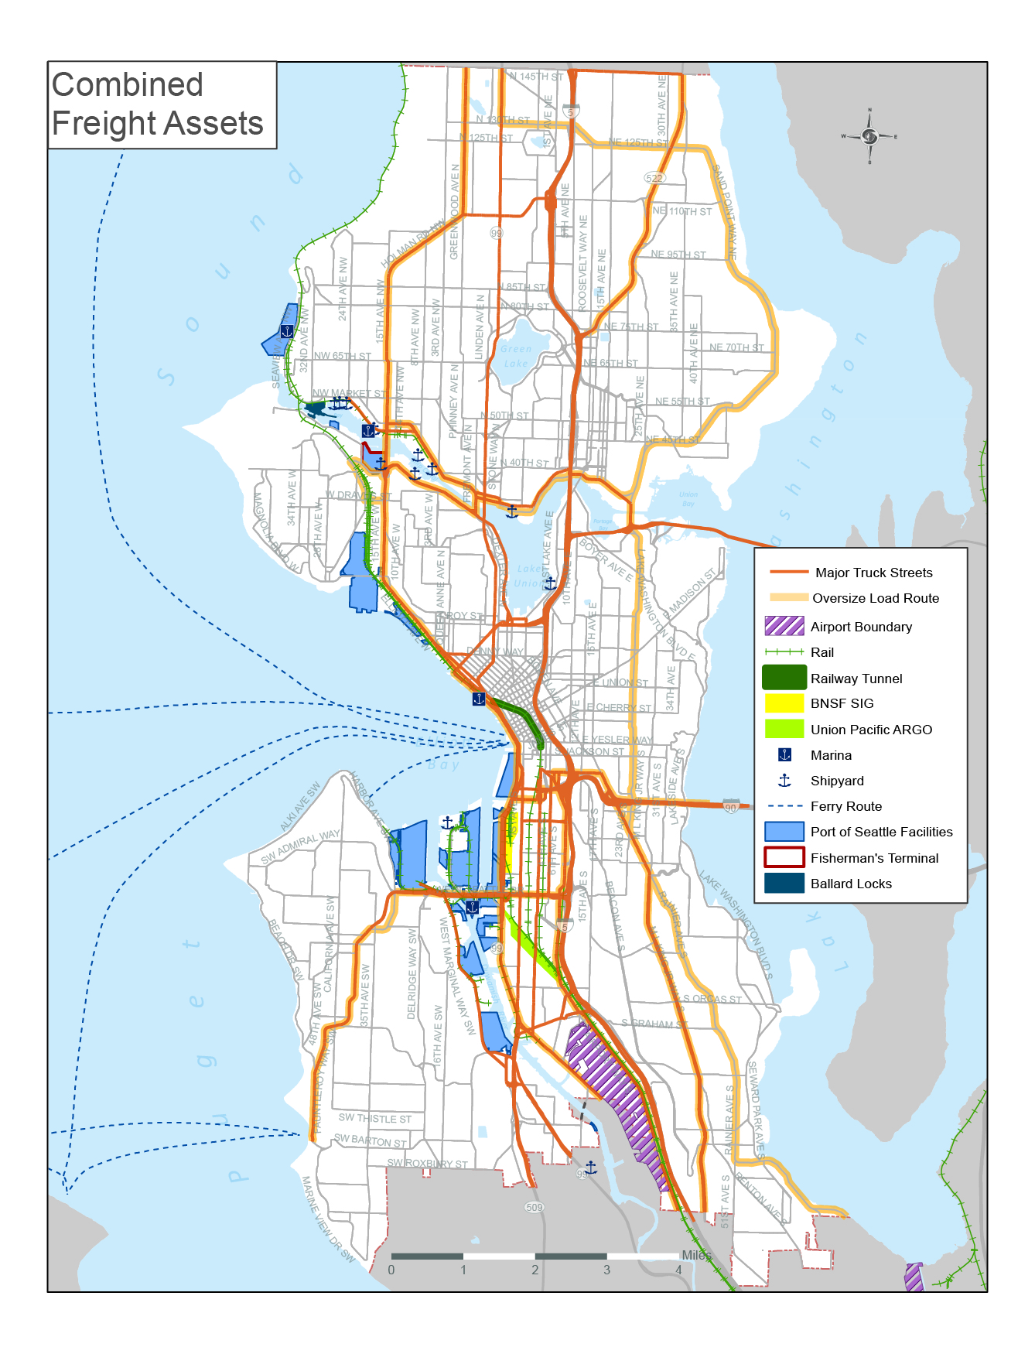
Existing conditions
142 miles of Major Truck Streets
Oversize load routes
Port of Seattle facilities
Intermodal rail facilities
KC International Airport
Notes:
The map shows Existing Major Truck Streets
Over legal routes
Port facilities
Airport
And links between facilities

Slide 7
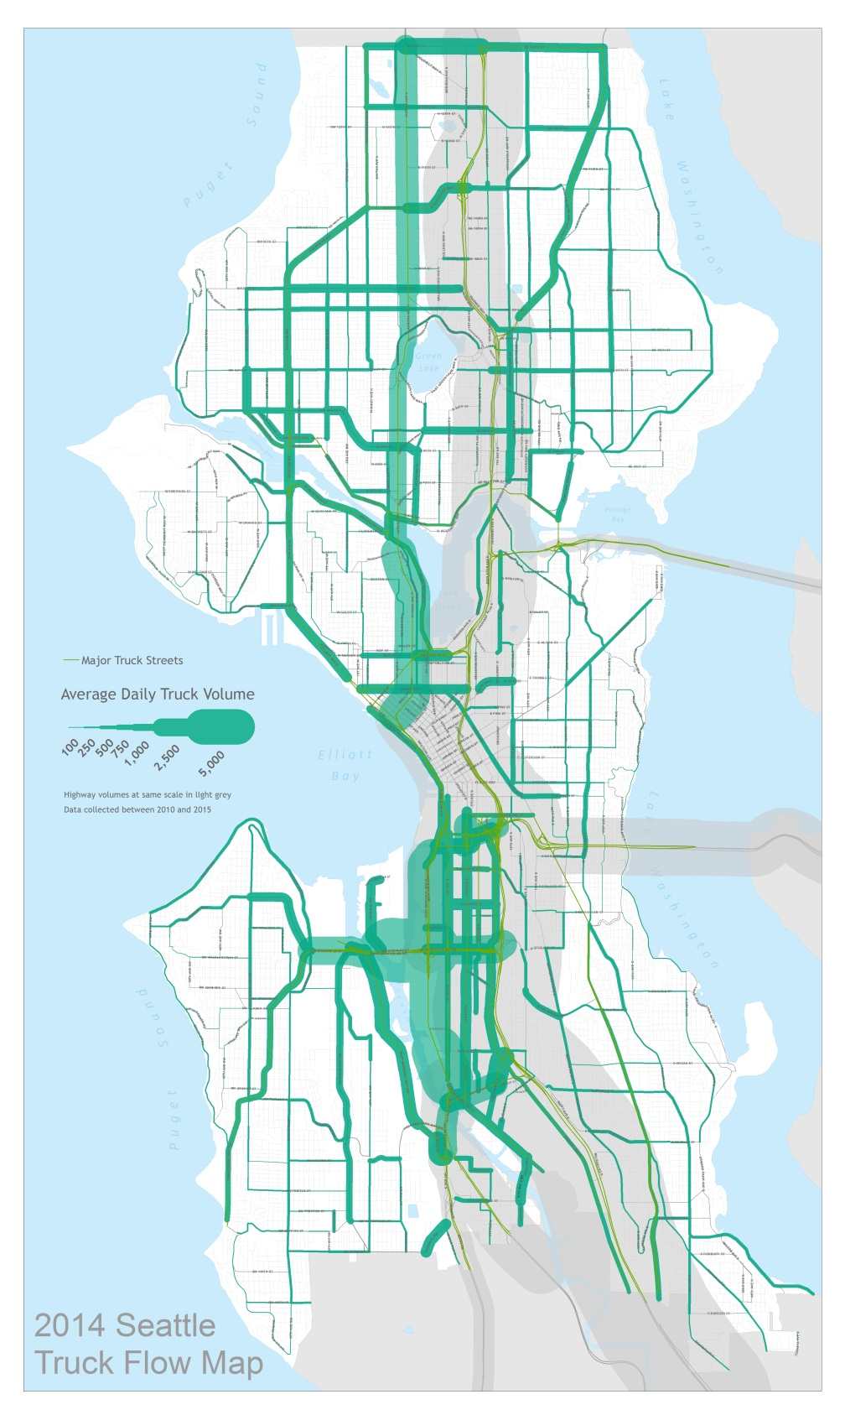
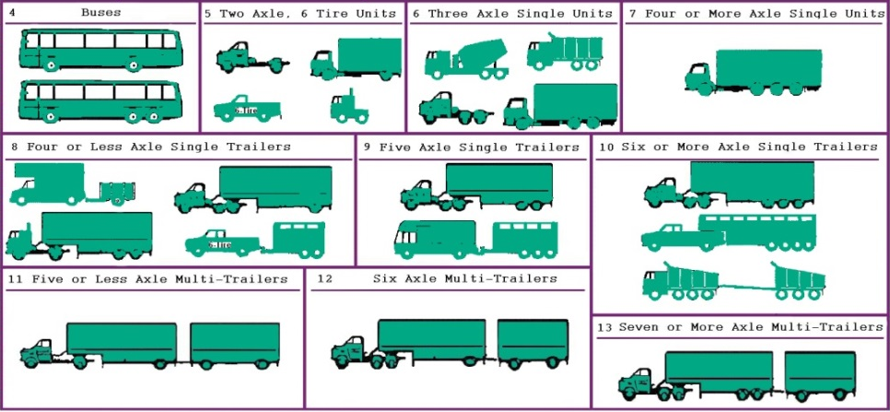
Existing conditions
2014 First truck flow map
City of Seattle: 780 count locations
Other input from WSDOT, KC Metro
Notes:
Second round of data collection has started

Slide 8
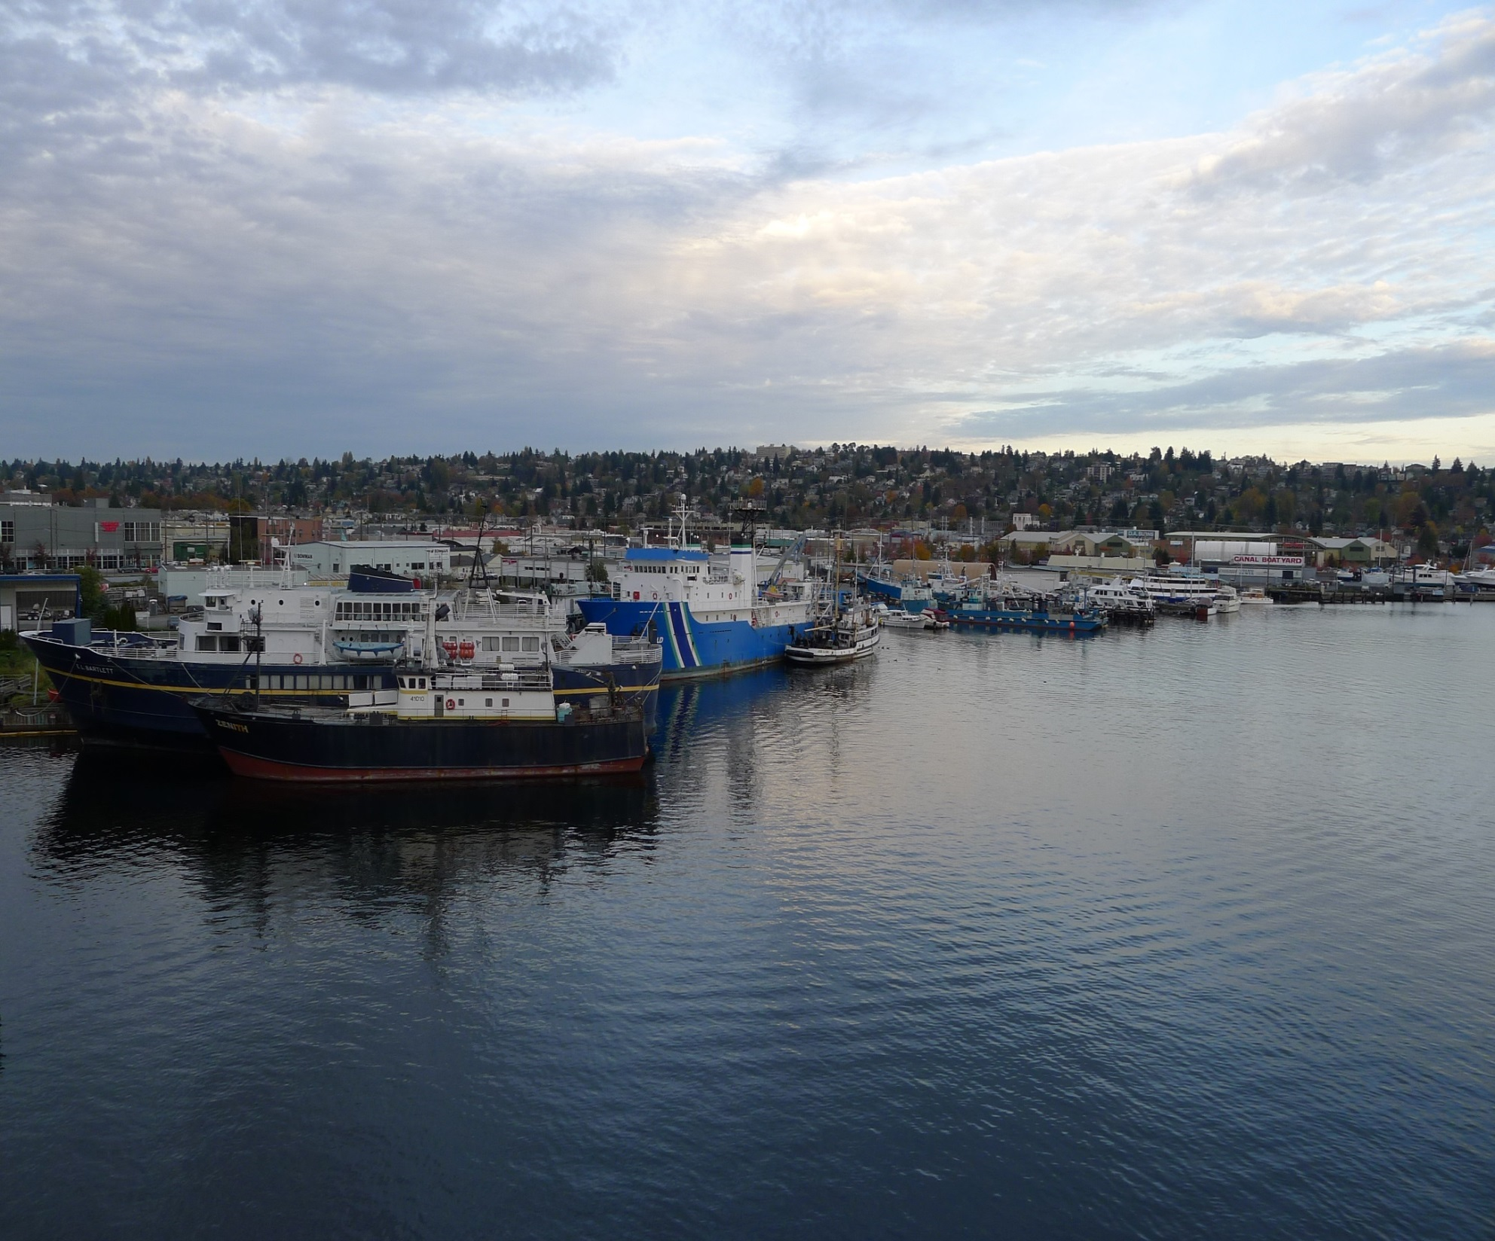
Policy framework
Vision themes:
Vibrant city
Thriving economy
Connecting people and products
Goal themes:
Economy
Safety
Mobility
State of Good Repair
Equity
Environment
Notes:
Talk about how the CAC proposed themes for the Vision and Goals that would provide outcomes for the FMP

Slide 9
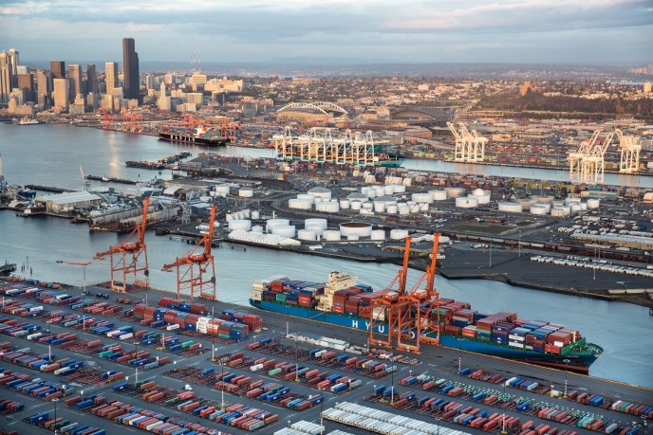
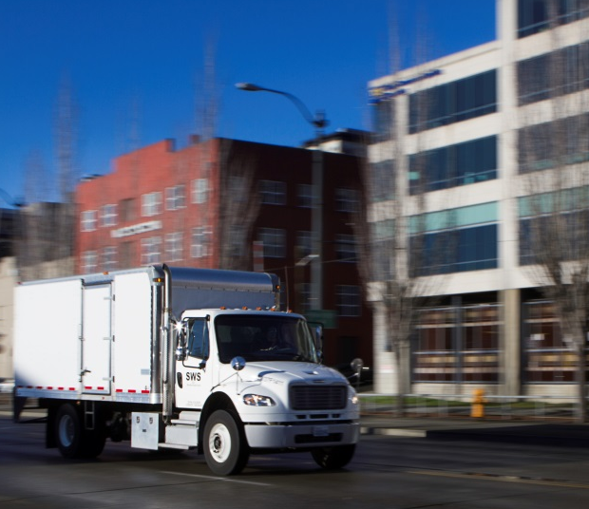

Draft FMP Vision Statement
A high-quality and aspiring statement that will help articulate the desired end state of the FMP.
PROPOSED VISION: A vibrant city and thriving economy connecting people and products within Seattle and to regional and international markets.
Notes:
Describe purpose of Policy Framework
Vision – desired result of FMP

Slide 10
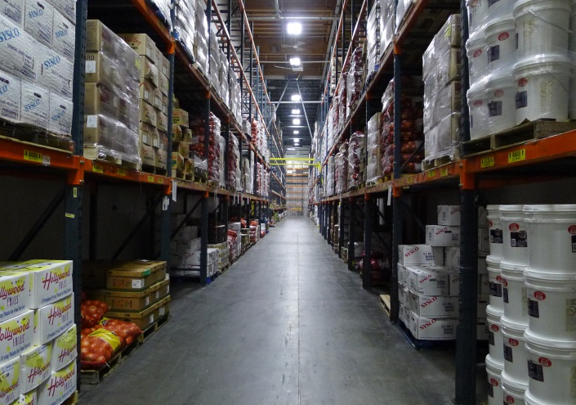
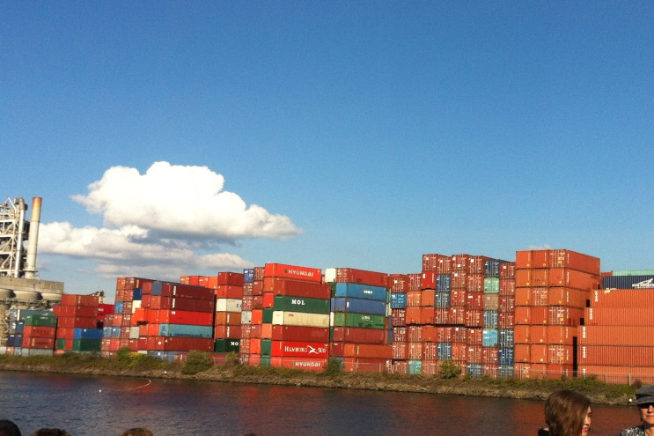
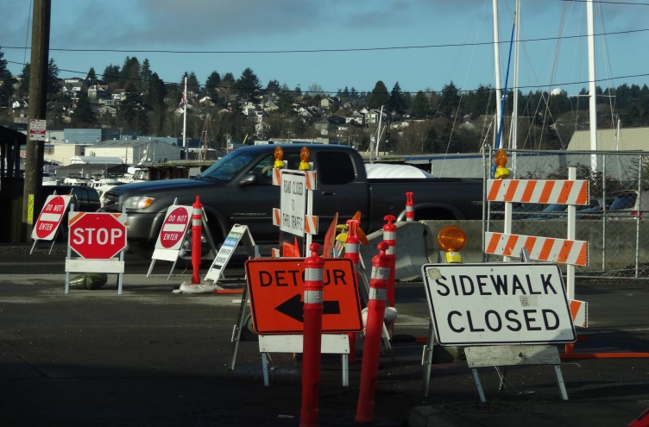
Draft FMP Goals
Economy – Provide a freight network that supports a growing economy for Seattle and the region.
Safety - Improve safety and the predictable movement of goods and people.
Notes:
Goals – What we want to accomplish in the plan
Goals will be used to establish performance metrics and prioritization
Stakeholders want safe and predictable movement of goods

Slide 11
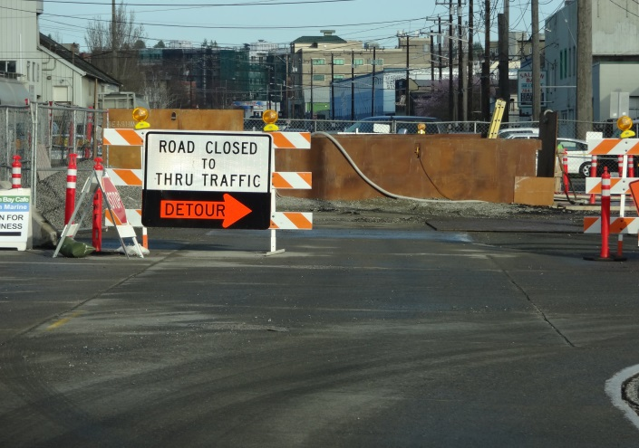
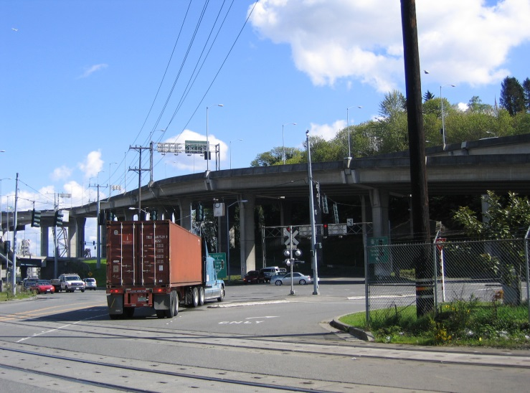
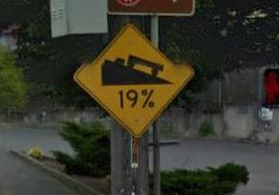
Draft FMP Goals (continued)
Mobility - Reliably connect manufacturing/industrial centers and business districts with the local, state, and international freight networks.
State of Good Repair – Maintain and improve the freight transportation network to ensure safe and efficient operations.
Notes:
Invest in freight projects that provide reliability to the system

Slide 12
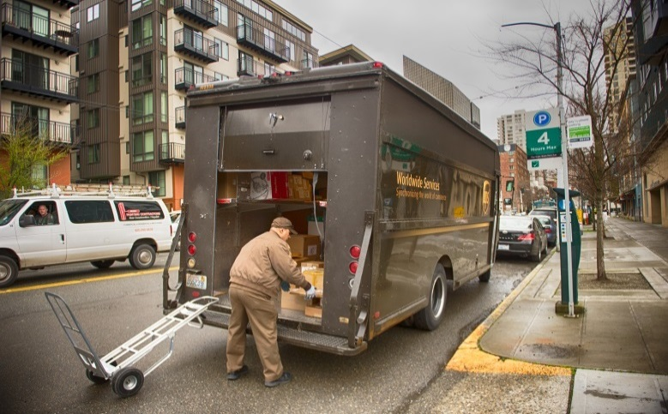

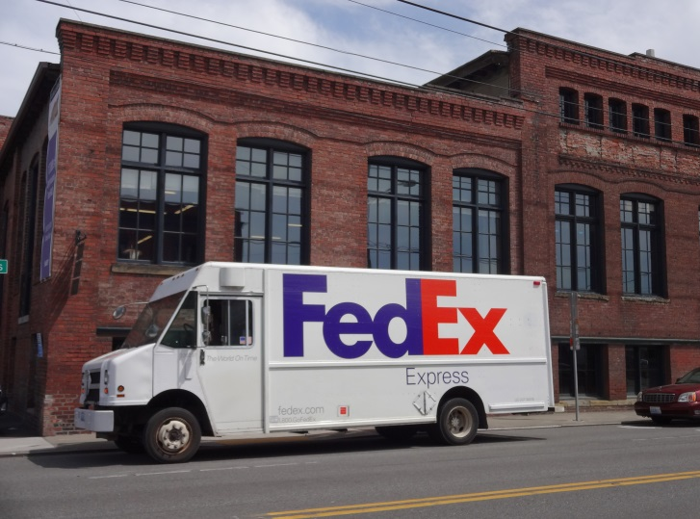
Draft FMP Goals (continued)
Equity – Benefit residents and businesses of Seattle through equity in freight investments and improve the health of communities impacted by freight movement.
Environment - Improve freight operations in Seattle and the region by making goods movement more efficient and reducing its environmental footprint
Notes:
living wage jobs. A lot of our economy is tied to the movement of goods.
Some communities are impacted more than others by the movements of goods. Negative environmental impacts should be minimum. Educate about the importance of freight-related jobs –

Slide 13
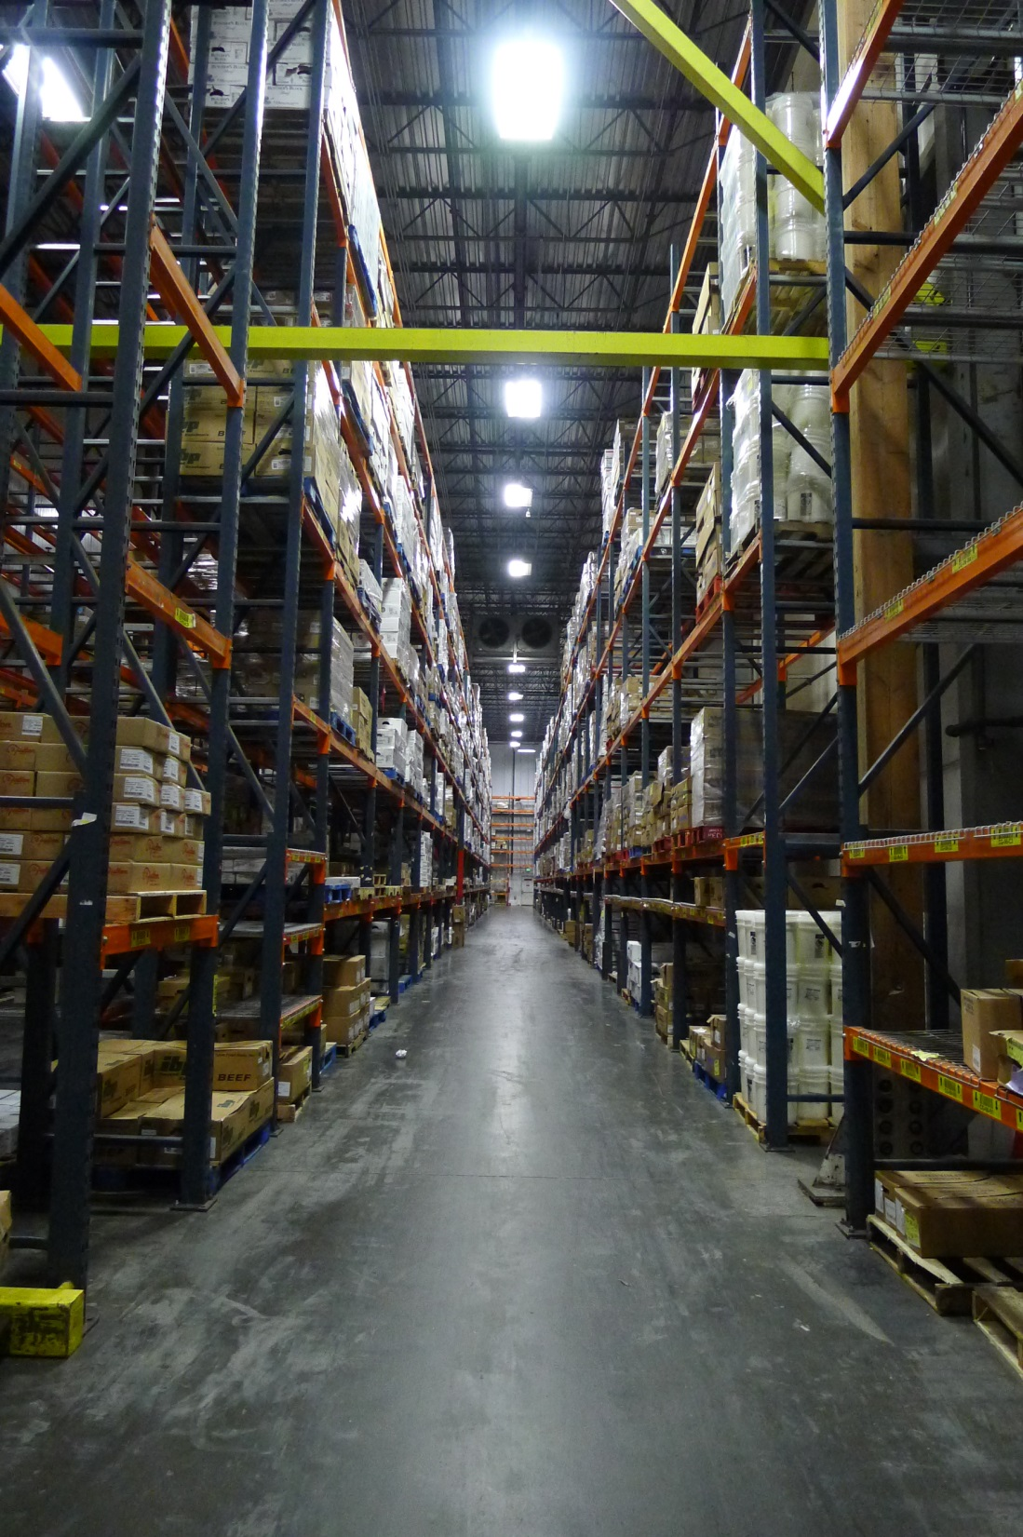
Supply Chain: Infographic
Provide goods and services from a source of production to the point of consumption
Many logistical steps to move one product
Infographic will serve as educational tool for the Freight Master Plan

Slide 14
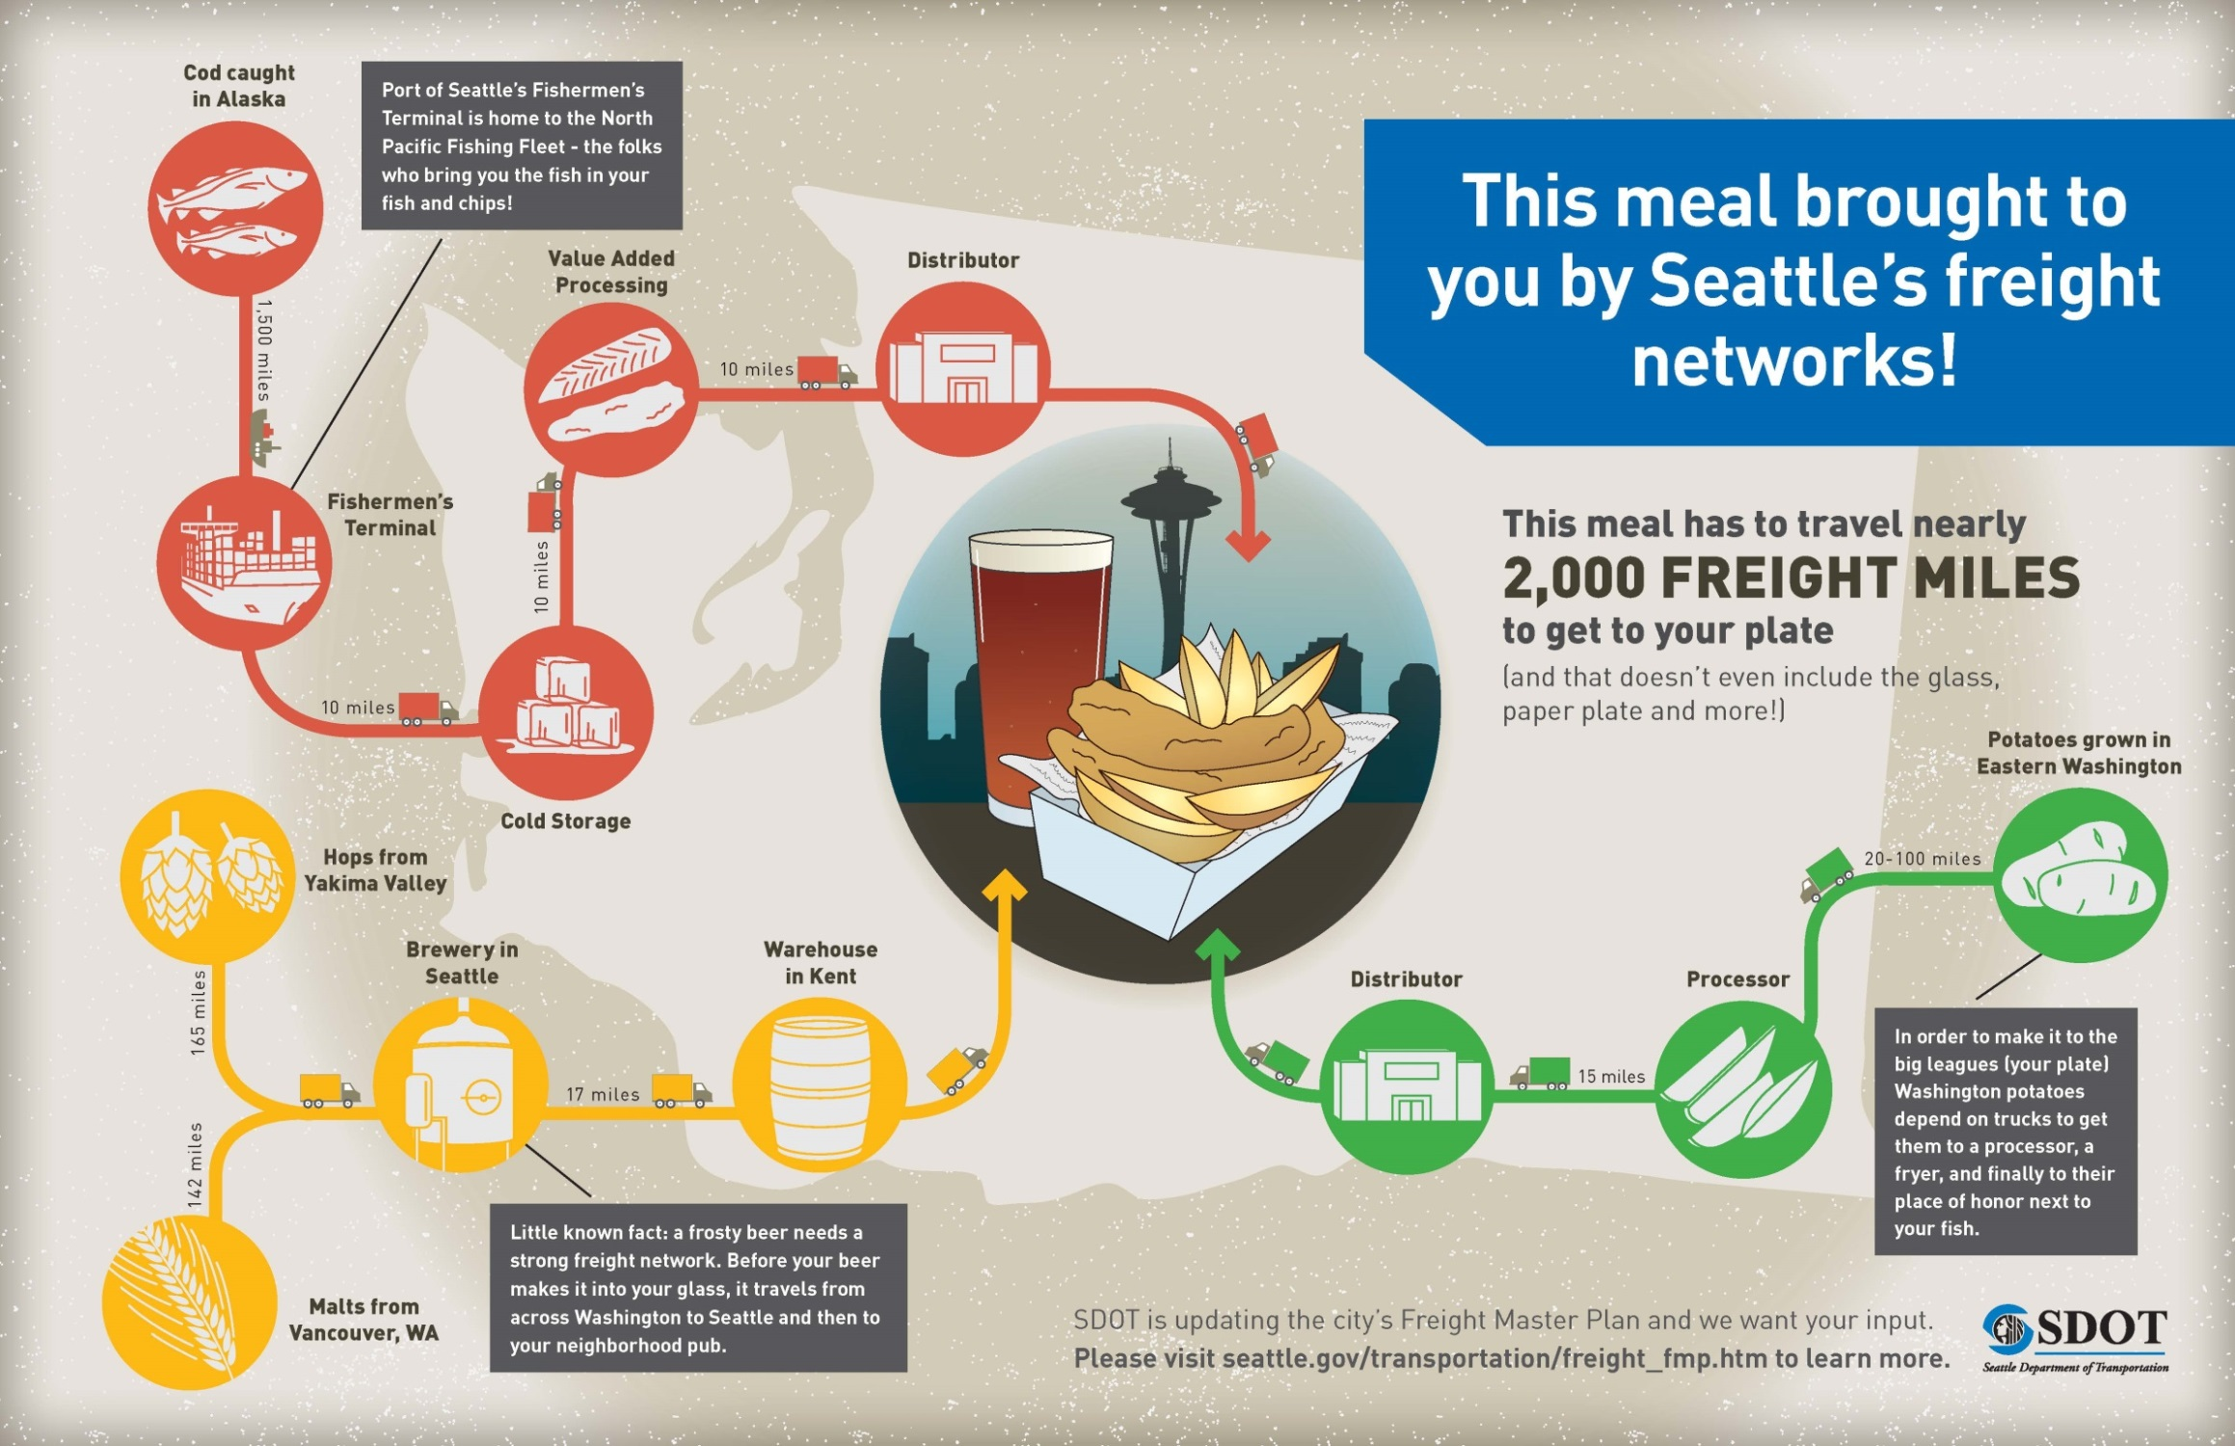

Slide 15
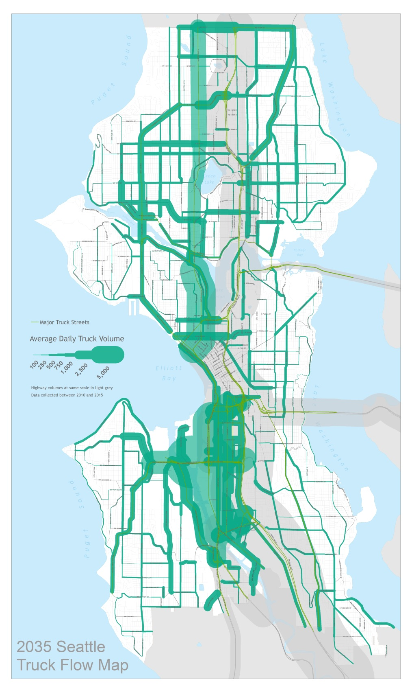
Future conditions
2035 Truck flow map
Create districts for analysis
Employment industries: Retail, Wholesale and Manufacturing
Develop Growth factors and apply to districts
Calibrate future volumes against other projects

Slide 16
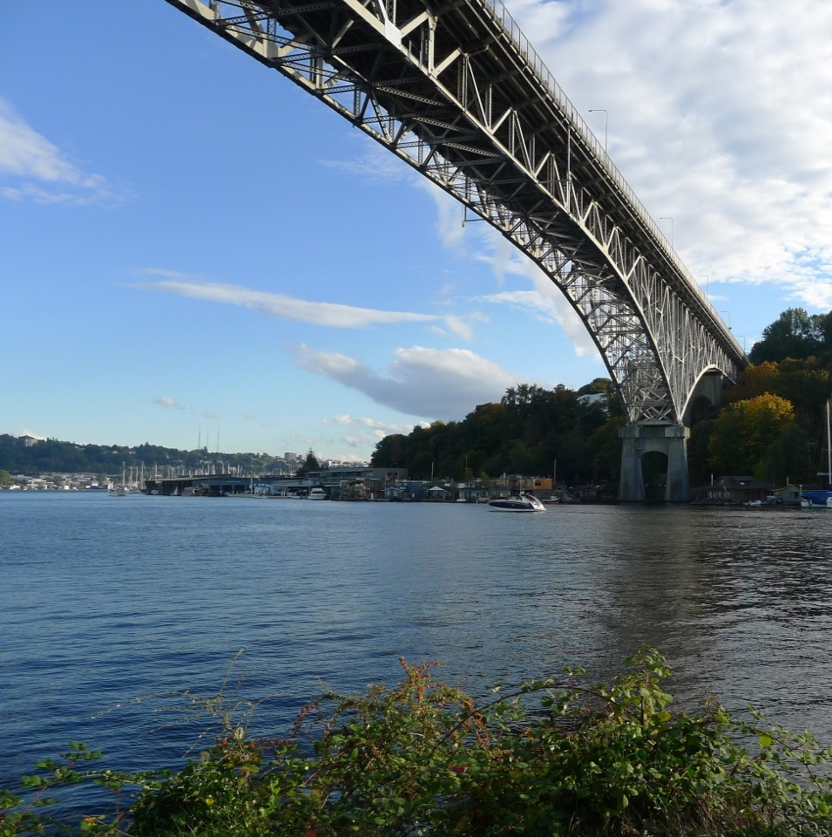
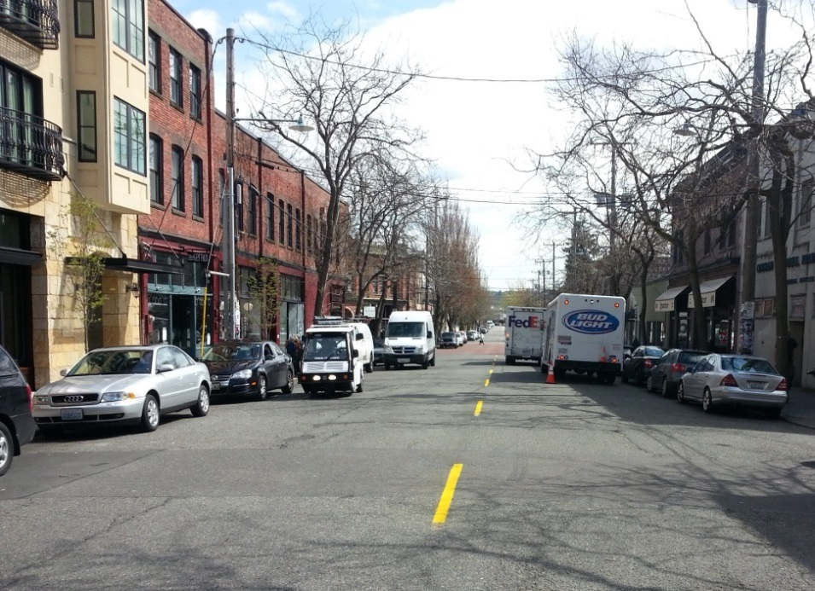
Seattle’s Draft Truck
Street Designation
Freight goes everywhere
Need to recognize different levels of freight movement and needs
Need for context sensitivity
Notes:
We looked at several cities, some similar to ours (Port, large MPA) and found a mix of street designations.
Committee supported a tiered system to serve the different levels of freight
This will serve to inform improvements

Slide 17
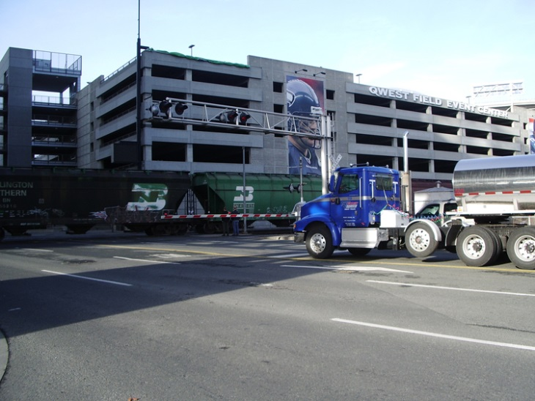
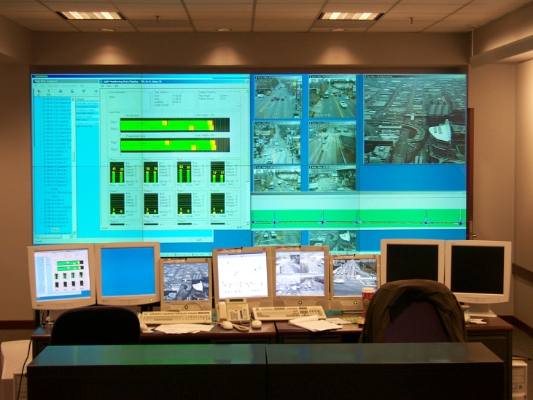
Seattle’s Draft Truck
Street Designation
Land use
Functional Classification
Truck Volume
Physical Roadway Characteristics
Connectivity
Tiered system
criteria
Notes:
Categories that help determine street designation

Slide 18
Refresher: Freight network criteria
Criteria | Limited Access Facility | Major Truck Street | Minor Truck Street | First/Last Mile Connectors
Functional Purpose | Long Distance Trips | Through Trips | To/From | Industrial Trips
Supports Freight-Generating Land Uses | Primary connections between industrial centers and the rest of the region | Main connections between industrial land use (Manufacturing Industrial Centers and intermodal terminals) | Provides connections between urban villages; commercial distribution network | Access to industrial uses
Roadway Classification | Highway | Minor arterial or higher | Minor arterial or higher | Minor arterial or lower
Truck Volume | All Volumes | 500+ trucks per day | 500+ trucks per day | 250+ trucks per day
Notes:
Emphasize purpose of developing a freight network (similar to other modal plans)
Emphasize TO vs THROUGH
Function and designation

Slide 19
Next steps
 | August | September | October | November | December | January
Refine draft network map
Public outreach
Design guidelines
Refine performance measures
Identify improvements
Develop implementation strategy
Development of draft plan
Release public review of draft plan
Notes:
Insert a project timeline. Clarify the process and opportunities for engagement/feedback.

Slide 20




Questions?
gabriela.vega@seattle.gov | (206) 733-9029
ian.macek@seattle.gov | (206) 684-7576
http://www.seattle.gov/transportation/freight.htm
http://www.seattle.gov/transportation

